Slide 2
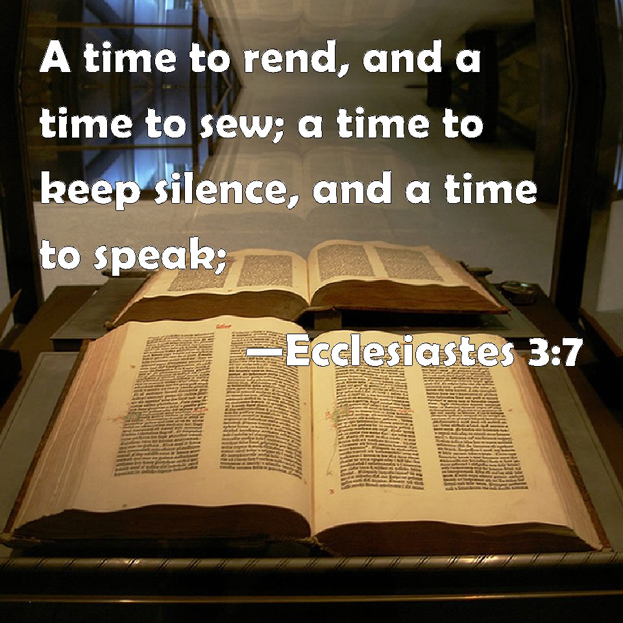
Ecclesiastes 3:1-8
Matthew 12:34,36,24,37
James 3:5-10
Proverbs 18:21; Psalm 39:1

Slide 3
“A Time To Keep Silent”
Proverbs 17:28 “Even a fool is counted wise when he holds his peace; When he shuts his lips, he is considered perceptive."
"Don't argue with fools, for bystanders will not be able to tell who the fool is."
Proverbs 26:4 “Do not answer a fool according to his folly, Lest you also be like him."

Slide 4
When Don’t Know All The Facts
Proverbs 18:13 “He who answers a matter before he hears it, It is folly and shame to him."
Proverbs 18:17 “The first one to plead his cause seems right, Until his neighbor comes and examines him."
When It Is None Of Our Business
John 21:21,22 “what is that to you?”
1 Thessalonians 4:10,11 “mind your own business”
1 Peter 4:15 “busybody in other people’s matters”
2 Thessalonians 3:10-12 “work in quietness and eat their own bread.”

Slide 5
When Our Words Would Destroy A Friendship
Proverbs 16:28 "A perverse man sows strife, And a whisperer separates the best of friends."
Never say anything about anybody that you wouldn't want to get back to them that you said.
If you are advised of something that someone has said about you, don't take it too seriously – Ecclesiastes 7:21,22

Slide 6
When Our Words Would Destroy A Reputation
Proverbs 16:27 "An ungodly man digs up evil, And it is on his lips like a burning fire."
1 Corinthians 13:7 love "bears all things, believes all things, hopes all things, endures all things."
Even if a matter is TRUE we need to ask:
“Is it KIND?” “Is it NECESSARY?” “Will it Help?”

Slide 7
When We Have Said It Many Times Before
Proverbs 19:13 “the contentions of a wife are a continual dripping."
Proverbs 27:15,16 “A continual dripping on a very rainy day And a contentious woman are alike;”
Husbands can be just as guilty! Parents to children!
“Is it productive or counterproductive?”
Ephesians 4:29

Slide 8
Be Silent When It’s Time To Listen
Proverbs 13:1 “A wise son heeds his father’s instruction, But a scoffer does not listen to rebuke."
James 1:19 “ let every man be swift to hear, slow to speak, slow to wrath;"
Ezekiel 3:14,15 “I sat where they sat, and remained there astonished among them seven days.”
Only then could he listen to God, and heed the words which were spoken to him.

Slide 9
Be Silent When It’s Time To Work
Proverbs 14:23 “idle chatter leads only to poverty."
John 9:4 “We must work the works of Him who sent Me while it is day”
Nehemiah 2:18; 4:6 "Let us rise up and build.” “the people had a mind to work."

Slide 10


May our God give us the wisdom to know when to be silent!

